Slide 1


International Economics: Theory and Policy
Twelfth Edition
Chapter 18
Fixed Exchange Rates and Foreign Exchange Intervention
Copyright © 2022, 2018, 2015 Pearson Education, Inc. All Rights Reserved
Notes:
If this PowerPoint presentation contains mathematical equations, you may need to check that your computer has the following installed:
1) MathType Plugin
2) Math Player (free versions available)
3) NVDA Reader (free versions available)
Slides in this presentation contain hyperlinks. JAWS users should be able to get a list of links by using INSERT+F7

Slide 2
Learning Objectives
18.1 Understand how a central bank must manage monetary policy so as to fix its currency’s value in the foreign exchange market.
18.2 Describe and analyze the relationship among the central bank’s foreign exchange reserves, its purchases and sales in the foreign exchange market, and the money supply.
18.3 Explain how monetary, fiscal, and sterilized intervention policies affect the economy under a fixed exchange rate.
18.4 Discuss causes and effects of balance of payments crises.
18.5 Describe how alternative multilateral systems for pegging exchange rates work

Slide 3
Preview
Balance sheets of central banks
Intervention in the foreign exchange markets and the money supply
How the central bank fixes the exchange rate
Monetary and fiscal policies under fixed exchange rates
Financial market crises and capital flight
Types of fixed exchange rates: reserve currency and gold standard systems

Slide 4
Introduction
Many countries try to fix or “peg” their exchange rate to a currency or group of currencies by intervening in the foreign exchange markets.
Many with a flexible or “floating” exchange rate in fact practice a managed floating exchange rate.
The central bank “manages” the exchange rate from time to time by buying and selling currency and assets, especially in periods of exchange rate volatility.
How do central banks intervene in the foreign exchange markets?

Slide 5
Central Bank Intervention and the Money Supply
To study the effects of central bank intervention in the foreign exchange markets, first construct a simplified balance sheet for the central bank.
This records the assets and liabilities of a central bank.
Balance sheets use double-entry bookkeeping: each transaction enters the balance sheet twice.

Slide 6
Central Bank’s Balance Sheet (1 of 2)
Assets
Foreign government bonds (official international reserves)
Gold (official international reserves)
Domestic government bonds
Loans to domestic banks (called discount loans in United States)
Liabilities
Deposits of domestic banks
Currency in circulation (previously central banks had to give up gold when citizens brought currency to exchange)

Slide 7
Central Bank’s Balance Sheet (2 of 2)
Assets = Liabilities + Net Worth
If assume that net worth is constant, then
An increase in assets leads to an equal increase in liabilities.
A decrease in assets leads to an equal decrease in liabilities.
Changes in the central bank’s balance sheet lead to changes in currency in circulation or changes in deposits of banks, which lead to changes in the money supply.
If their deposits at the central bank increase, banks are usually able to use these additional funds to lend to customers, so amount of money in circulation increases.

Slide 8
Assets, Liabilities, and the Money Supply (1 of 2)
A purchase of any asset by the central bank will be paid for with currency or a check written from the central bank,
both of which are denominated in domestic currency, and
both of which increase the supply of money in circulation.
The transaction leads to equal increases of assets and liabilities.
When the central bank buys domestic bonds or foreign bonds, the domestic money supply increases.

Slide 9
Assets, Liabilities, and the Money Supply (2 of 2)
A sale of any asset by the central bank will be paid for with currency or a check written to the central bank,
both of which are denominated in domestic currency.
The central bank puts the currency into its vault or reduces the amount of deposits of banks,
causing the supply of money in circulation to shrink.
The transaction leads to equal decreases of assets and liabilities.
When the central bank sells domestic bonds or foreign bonds, the domestic money supply decreases.

Slide 10
Table 18.1 Effects of a $100 Foreign Exchange Intervention: Summary
Domestic Central Bank’s Action | Effect on Domestic Money Supply | Effect on Central Bank’s Domestic Assets | Effect on Central Bank’s Foreign Assets
Nonsterilized foreign exchange purchase | +$100 | 0 | +$100
Sterilized foreign exchange purchase | 0 | Negative $100 | +$100
Nonsterilized foreign exchange sale | Negative $100 | 0 | Negative $100
Sterilized foreign exchange sale | 0 | +$100 | Negative $100

Slide 11
Foreign Exchange Markets
Central banks trade foreign government bonds in the foreign exchange markets.
Foreign currency deposits and foreign government bonds are often substitutes: both are fairly liquid assets denominated in foreign currency.
Quantities of both foreign currency deposits and foreign government bonds that are bought and sold influence the exchange rate.

Slide 12
Sterilization
Because buying and selling of foreign bonds in the foreign exchange markets affects the domestic money supply, a central bank may want to offset this effect.
This offsetting effect is called sterilization.
If the central bank sells foreign bonds in the foreign exchange markets, it can buy domestic government bonds in bond markets—hoping to leave the amount of money in circulation unchanged.

Slide 13
Fixed Exchange Rates (1 of 4)
To fix the exchange rate, a central bank influences the quantities supplied and demanded of currency by trading domestic and foreign assets, so that the exchange rate (the price of foreign currency in terms of domestic currency) stays constant.
Foreign exchange markets are in equilibrium when
When the exchange rate is fixed at some level
and the
market expects it to stay fixed at that level, then

Slide 14
Fixed Exchange Rates (2 of 4)
To fix the exchange rate, the central bank must trade foreign and domestic assets in the foreign exchange market until
Alternatively, we can say that it adjusts the quantity of monetary assets in the money market until the domestic interest rate equals the foreign interest rate, given the level of average prices and real output:

Slide 15
Fixed Exchange Rates (3 of 4)
Suppose that the central bank has fixed the exchange
rate at
but the level of output rises, raising the
demand of real monetary assets.
This is predicted to put upward pressure on interest rates and the value of the domestic currency.
How should the central bank respond if it wants to fix exchange rates?

Slide 16
Fixed Exchange Rates (4 of 4)
The central bank should buy foreign assets in the foreign exchange markets,
thereby increasing the domestic money supply,
thereby reducing interest rates in the short run.
Alternatively, by demanding (buying) assets denominated in foreign currency and by supplying (selling) domestic currency, the price/value of foreign currency is increased and the price/value of domestic currency is decreased.

Slide 17
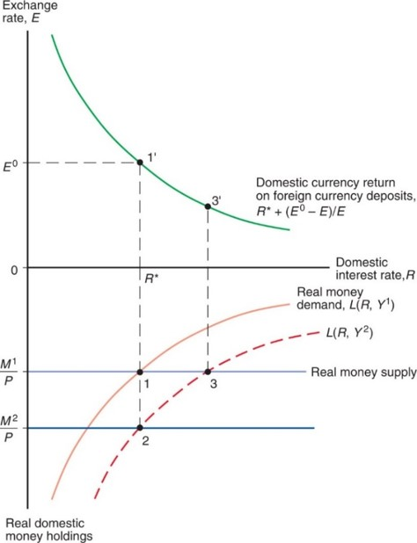
Figure 18.1 Asset Market Equilibrium With a Fixed Exchange Rate, E sub 0
To hold the exchange rate fixed at
when output rises from
the central
bank must purchase foreign assets and thereby raise the money supply from
Notes:
Above y = 0, there is a plot for domestic currency return on foreign deposits, R asterisk + left parenthesis E super 0 minus E right parenthesis over E. The plot falls with decreasing steepness through point 1 prime, (R asterisk, E super 0), and then 3 prime. Below y = 0, the plot for real money demand, L left parenthesis R, Y super 1, right parenthesis, rises with decreasing steepness through point 1, at (R asterisk, M super 1 over p), where y = real money supply. The plot is shifted downward and to the right for L left parenthesis R, Y super 2, right parenthesis, which passes through point 2 at (R asterisk, M super 2 over P), and then point 3, which located at the same x-value as point 3 prime above, where y = real money supply.

Slide 18
Monetary Policy and Fixed Exchange Rates
When the central bank buys and sells foreign assets to keep the exchange rate fixed and to maintain domestic interest rates equal to foreign interest rates, it is not able to adjust domestic interest rates to attain other goals.
In particular, monetary policy is ineffective in influencing output and employment.

Slide 19
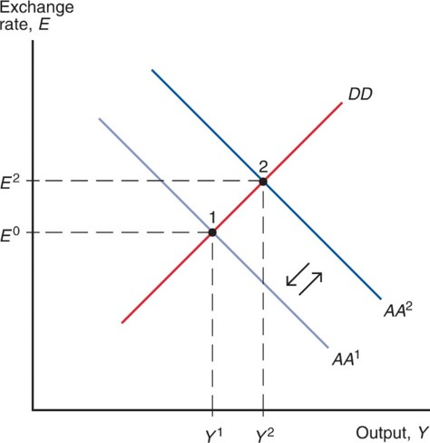
Figure 18.2 Monetary Expansion Is Ineffective Under a Fixed Exchange Rate
Initial equilibrium is shown at point 1, where the output and asset markets simultaneously
clear at a fixed exchange rate of
and an output level of
Hoping to increase output to
the central bank decides to increase the money supply by buying domestic assets and
shifting
Because the central bank must maintain
however, it has to sell
foreign assets for domestic currency, an action that decreases the money supply
immediately and returns
The economy’s equilibrium therefore remains at
point 1, with output unchanged at
Notes:
The D D curve is a rising line that intersects a falling Ay Ay super 1 line at point 1, (Y super 1, E super 0). The Ay Ay super 2 line is parallel to Ay Ay super 1, and intersects D D at point 2, (Y super 2, E super 2), which is above and right of point 1. Arrows in both directions between Ay Ay 1 and Ay Ay 2 indicate shifts in either direction.

Slide 20
Fiscal Policy and Fixed Exchange Rates in the Short Run
Temporary changes in fiscal policy are more effective in influencing output and employment in the short run:
The rise in aggregate demand and output due to expansionary fiscal policy raises demand for real monetary assets, putting upward pressure on interest rates and on the value of the domestic currency.
To prevent an appreciation of the domestic currency, the central bank must buy foreign assets, thereby increasing the money supply and decreasing interest rates.

Slide 21
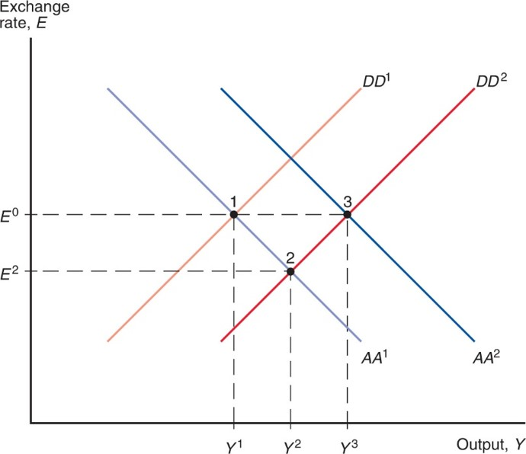
Figure 18.3 Fiscal Expansion Under a Fixed Exchange Rate
Fiscal expansion (shown by the shift from
and the
intervention that accompanies it (the shift from
move the
economy from point 1 to point 3.
Notes:
The graph has two sets of parallel lines that show fiscal expansion under a fixed exchange rate. Lines D D super 1 and D D super 2 are parallel and rising, intersecting the falling lines, Ay Ay super 1 and Ay Ay super 2. D D super 1 intersects Ay Ay super 1 at point 1, (Y super 1, E super 0). D D super 2 intersects Ay Ay super 1 at point 2, (Y super 2, E super 2), below and to the right of point 1. Ay Ay super 2 intersects D D super 2 at point 3, (Y super 3, E super 0), which is to the right of point 1 at the same y-value.

Slide 22
Fiscal Policy and Fixed Exchange Rates in the Long Run (1 of 2)
When the exchange rate is fixed, there is no real appreciation of the value of domestic products in the short run.
But when output is above its potential level, wages and prices tend to rise in the long run.
A rising price level makes domestic products more expensive:
a real appreciation
Aggregate demand and output decrease as prices rise: D D curve shifts left.
Prices tend to rise until employment, aggregate demand, and output fall to their normal (potential or natural) levels.

Slide 23
Fiscal Policy and Fixed Exchange Rates in the Long Run (2 of 2)
Prices are predicted to change proportionally to the change in the money supply when the central bank intervenes in the foreign exchange markets.
A A curve shifts down (left) as prices rise.
Nominal exchange rates will be constant (as long as the fixed exchange rate is maintained), but the real exchange rate will be lower (a real appreciation).

Slide 24
Devaluation and Revaluation
Depreciation and appreciation refer to changes in the value of a currency due to market changes.
Devaluation and revaluation refer to changes in a fixed exchange rate caused by the central bank.
With devaluation, a unit of domestic currency is made less valuable, so that more units must be exchanged for 1 unit of foreign currency.
With revaluation, a unit of domestic currency is made more valuable, so that fewer units need to be exchanged for 1 unit of foreign currency.

Slide 25
Devaluation
For devaluation to occur, the central bank buys foreign assets, so that domestic monetary assets increase and domestic interest rates fall, causing a fall in the rate return on domestic currency deposits.
Domestic products become less expensive relative to foreign products, so aggregate demand and output increase.
Official international reserve assets (foreign bonds) increase.

Slide 26
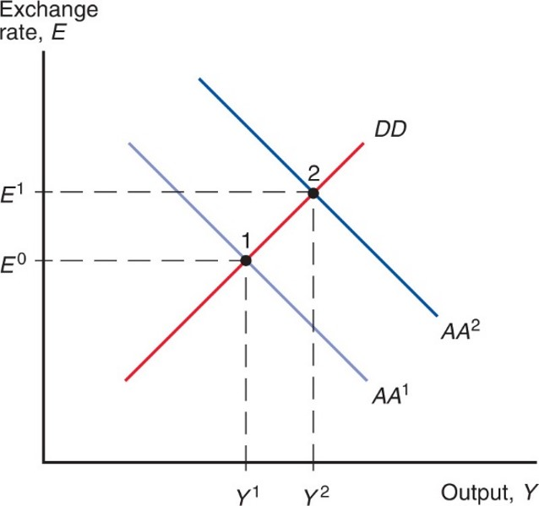
Figure 18.4 Effect of a Currency Devaluation
When a currency is devalued from
the economy’s
equilibrium moves from point 1 to point 2 as both output and the money supply expand.
Notes:
The graph has D D rising and intersecting two falling parallel lines, Ay Ay super 1 and Ay Ay super 2. D D intersects Ay Ay super 1 at point 1, (Y super 1, E super 0). D D then intersects Ay Ay super 2 at point 2, (Y super 2, E super 1), which is above and to the right of point 1.

Slide 27
Financial Crises and Capital Flight (1 of 6)
When a central bank does not have enough official international reserve assets to maintain a fixed exchange rate, a balance of payments crisis results.
To sustain a fixed exchange rate, the central bank must have enough foreign assets to sell in order to satisfy the demand of them at the fixed exchange rate.

Slide 28
Financial Crises and Capital Flight (2 of 6)
Investors may expect that the domestic currency will be devalued, causing them to want foreign assets instead of domestic assets, whose value is expected to fall soon.
This expectation or fear only makes the balance of payments crisis worse:
Investors rush to change their domestic assets into foreign assets, depleting the stock of official international reserve assets more quickly.

Slide 29
Financial Crises and Capital Flight (3 of 6)
As a result, financial capital is quickly moved from domestic assets to foreign assets: capital flight.
The domestic economy has a shortage of financial capital for investment and has low aggregate demand.
To avoid this outcome, domestic assets must offer high interest rates to entice investors to hold them.
The central bank can push interest rates higher by reducing the money supply (by selling foreign and domestic assets).
As a result, the domestic economy may face high interest rates, a reduced money supply, low aggregate demand, low output, and low employment.

Slide 30
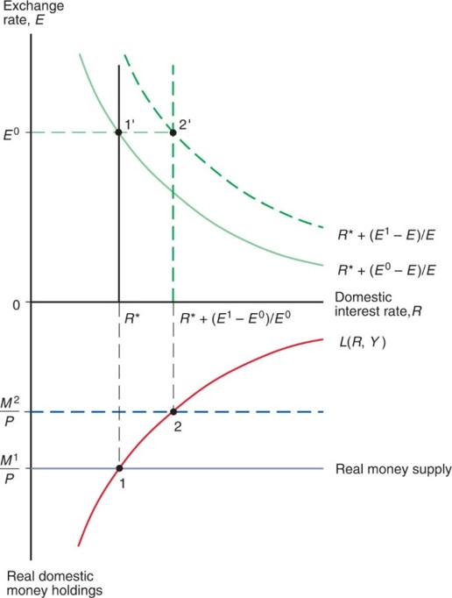
Figure 18.5 Capital Flight, the Money Supply, and the Interest Rate
To hold the exchange rate fixed at
after the market decides it will be devalued
to
the central bank must use its reserves to finance a private financial
outflow that shrinks the money supply and raises the home interest rate.
Notes:
Above y = 0, the plot for, R asterisk + left parenthesis E super 0 minus E right parenthesis over E, falls with decreasing steepness through point 1 prime, at (R asterisk, E super 0). The plot is shifted up and to the right for parallel plot, R asterisk + left parenthesis E super 1 minus E right parenthesis over E, which falls through point 2 prime, where x = R asterisk + left parenthesis E super 1 minus E super 0, right parenthesis, over E super 0, and y = E super 0. Below y = 0, the plot for L left parenthesis R, Y right parenthesis, rises with decreasing steepness through point 1, at (R asterisk, M super 1 over P), where y = real money supply. The plot then rises through point 2, where y = R asterisk + left parenthesis E super 1 minus E super 0, right parenthesis, over E super 0, and y = M super 2 over P.

Slide 31
Financial Crises and Capital Flight (4 of 6)
Expectations of a balance of payments crisis only worsen the crisis and hasten devaluation.
What causes expectations to change?
Expectations about the central bank’s ability and willingness to maintain the fixed exchange rate.
Expectations about the economy: shrinking demand of domestic products relative to foreign products means that the domestic currency should become less valuable.
In fact, expectations of devaluation can cause a devaluation: a self-fulfilling crisis.

Slide 32
Financial Crises and Capital Flight (5 of 6)
What happens if the central bank runs out of official international reserve assets (foreign assets)?
It must devalue the domestic currency so that it takes more domestic currency (assets) to exchange for 1 unit of foreign currency (asset).
This will allow the central bank to replenish its foreign assets by buying them back at a devalued rate,
increasing the money supply,
reducing interest rates,
reducing the value of domestic products,
increasing aggregate demand, output, and employment over time.

Slide 33
Financial Crises and Capital Flight (6 of 6)
In a balance of payments crisis,
the central bank may buy domestic bonds and sell domestic currency (to increase the money supply) to prevent high interest rates, but this only depreciates the domestic currency more.
the central bank generally cannot satisfy the goals of low domestic interest rates (relative to foreign interest rates) and fixed exchange rates simultaneously.

Slide 34
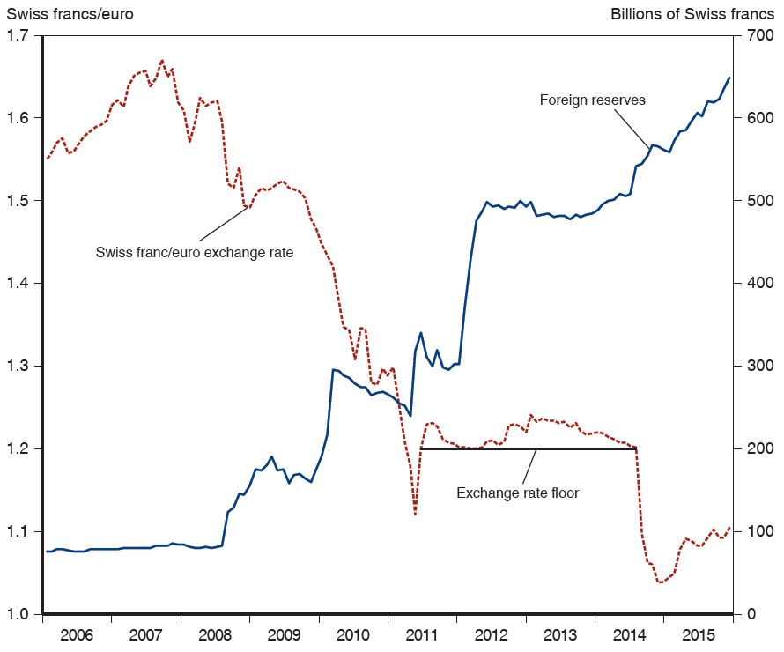
Figure 18.6 The Swiss Franc’s Exchange Rate against the Euro and Swiss Foreign Exchange Reserves, 2006–2016
The Swiss National Bank intervened heavily to slow the Swiss franc’s appreciation against the euro, setting a floor under the price of the euro in September 2011 and abandoning that floor in January 2015.
Source: Swiss National Bank.
Notes:
The plot for foreign reserves generally rises from (January 2006, 90 billion) through (January 2012, 1500 billion) to (January 2016, 650 billion). The plot for Swiss franc to euro exchange generally rises from (January 2006, 1.55) to (September 2007, 1.66) and then generally falls through (January 2010, 1.4) to a dip in (July 2011, 1.12). The exchange rate floor is a horizontal line plotted from July 2011 to July 2014, at y = 1.2. The plot for Swiss franc to euro exchange rises to above the exchange rate floor during that period, peaking at (January 2014, 1.24), and then dips to (January 2015, 1.05) before rising generally to (January 2016, 1.11). The plots for Swiss franc to euro exchange and foreign reserves intersect in January 2011 at 1.26 and 260 billion Swiss francs, respectively. All values estimated.

Slide 35
Interest Rate Differentials (1 of 3)
For many countries, the expected rates of return are not
the same:
Why?
Default risk: The risk that the country’s borrowers will default on their loan repayments. Lenders therefore require a higher interest rate to compensate for this risk.
Exchange rate risk: If there is a risk that a country’s currency will depreciate or be devalued, then domestic borrowers must pay a higher interest rate to compensate foreign lenders.

Slide 36
Interest Rate Differentials (2 of 3)
Because of these risks, domestic assets and foreign assets are not treated the same.
Previously, we assumed that foreign and domestic currency deposits were perfect substitutes: deposits everywhere were treated as the same type of investment, because risk and liquidity of the assets were assumed to be the same.
In general, foreign and domestic assets may differ in the amount of risk that they carry: they may be imperfect substitutes.
Investors consider these risks, as well as rates of return on the assets, when deciding whether to invest.

Slide 37
Interest Rate Differentials (3 of 3)
A difference in the risk of domestic and foreign assets is one reason why expected rates of return are not equal across countries:
where
is called a risk premium, an additional amount
needed to compensate investors for investing in risky domestic assets.
The risk could be caused by default risk or exchange rate risk.

Slide 38
The Rescue Package: Reducing rho
The United States and I M F set up a $50 billion fund to guarantee the value of loans made to Mexico’s government,
reducing default risk,
and reducing exchange rate risk, since foreign loans could act as official international reserves to stabilize the exchange rate if necessary.
After a recession in 1995, the economy began to recover.
Mexican goods were relatively inexpensive, allowing production to increase.
Increased demand of Mexican products relative to demand of foreign products stabilized the value of the peso and reduced exchange rate risk.

Slide 39
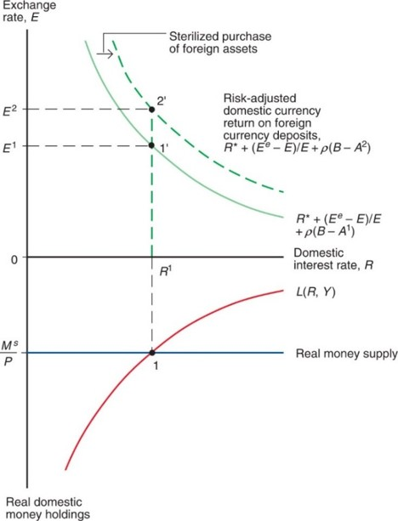
Figure 18.7 Effect of a Sterilized Central Bank Purchase of Foreign Assets Under Imperfect Asset Substitutability
A sterilized purchase of foreign assets leaves the money supply unchanged but raises the risk-adjusted return that domestic currency deposits must offer in equilibrium. As a result, the return curve in the upper panel shifts up and to the right. Other things equal,
this depreciates the domestic currency from
Notes:
Above y = 0, a plot for, R asterisk + left parenthesis upper E super lower e minus E right parenthesis, over quantity E + rho left parenthesis B minus Ay super 1, right parenthesis, falls through point 1 prime, at (R super 1, E super 1). The plot is shifted up and to the right due to the sterilized purchase of foreign assets to a risk-adjusted domestic currency return on foreign currency deposits, R asterisk + left parenthesis upper E super lower e minus E right parenthesis, over quantity E + rho left parenthesis B minus Ay super 2, right parenthesis. The plot falls through point prime 2, at (R super 1, E super 2). Below y = 0, the plot for L left parenthesis R, Y right parenthesis, rises with decreasing steepness through point 1, at (R super 1, M super s over P), where y = real money supply.

Slide 40
Types of Fixed Exchange Rate Systems
Reserve currency system: one currency acts as official international reserves
The U.S. dollar was the currency that acted as official international reserves from under the fixed exchange rate system from 1944 to 1973.
All countries except the United States held U.S. dollars as the means to make official international payments.
Gold standard: gold acts as official international reserves that all countries use to make official international payments.

Slide 41
Reserve Currency System
From 1944 to 1973, central banks throughout the world fixed the value of their currencies relative to the U.S. dollar by buying or selling domestic assets in exchange for dollar denominated assets.
Arbitrage ensured that exchange rates between any two currencies
remained fixed.
Suppose Bank of Japan fixed the exchange rate at
and the Bank of France fixed the exchange rate at
The yen/franc rate was
If not, then currency traders could make an easy profit by buying currency where it was cheap and selling it where it was expensive.

Slide 42
Gold and Silver Standard
Bimetallic standard: the value of currency is based on both silver and gold.
The United States used a bimetallic standard from 1837 to 1861.
Banks coined specified amounts of gold or silver into the national currency unit.
371.25 grains of silver or 23.22 grains of gold could be turned into a silver or a gold dollar
So gold was worth
times as much as silver.
See
www.micheloud.com
for a fun description of the bimetallic
standard, the gold standard after 1873, and the Wizard of Oz!

Slide 43
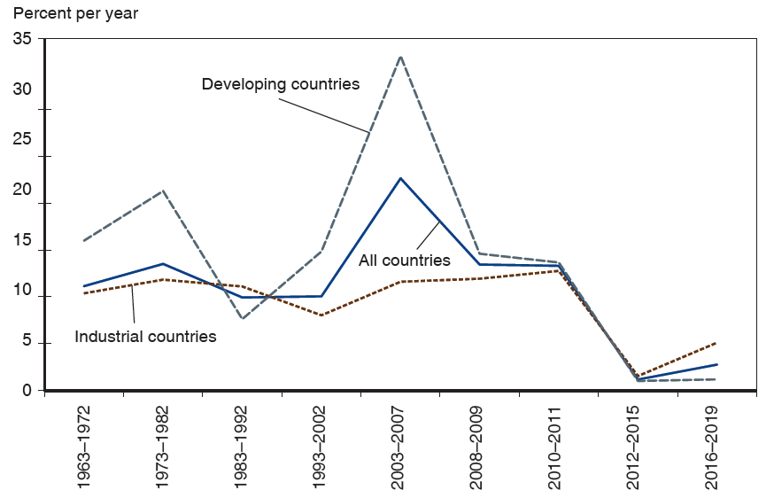
Figure 18.8 Growth Rates of International Reserves
Annualized growth rates of international reserves did not decline sharply after the early 1970s. Recently, developing countries have added large sums to their reserve holdings, but their pace of accumulation has slowed starting with the crisis years of 2008–2009. The figure shows averages of annual growth rates.
Source: International Monetary Fund.
Notes:
Developing countries, industrial countries, and all countries. The plot for developing countries falls from (19 63 to 19 72, 17) to (19 83 to 19 92, 12) and then rises to a peak at (20 03 to 20 07, 28), after which it falls to (20 12 to 20 15, 1), and passes through to (20 16 to 20 19, 1). The plot for industrial countries generally falls (19 63 to 19 72, 11) to (19 93 to 20 02, 9), then rises to a peak at (20 03 to 20 07, 22), after which if falls through (20 08 to 20 09, 13) to (20 12 to 20 15, 3), and then rises through (20 16 to 20 19, 3). The plot for industrial countries falls from (19 63 to 19 72, 9) to (19 73 to 19 82, 6), then rises to (19 83 to 19 92, 12) before falling again to (19 93 to 20 02, 5), it then rises to (20 10 to 20 11, 13), before falling to (20 12 to 20 15, 3), and then rises through (20 16 to 20 19, 6). All values are estimated.

Slide 44
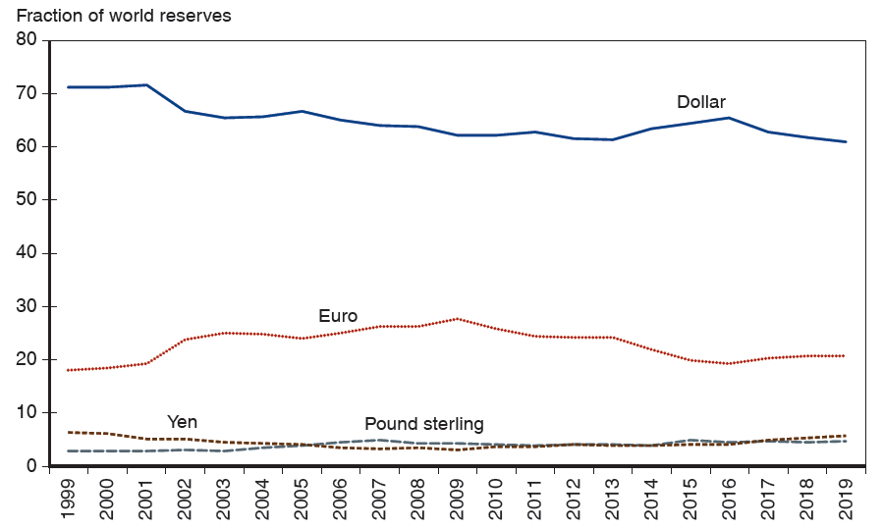
Figure 18.9 Currency Composition of Global Reserve Holdings
While the euro’s role as a reserve currency increased during the first decade of its existence, it has taken a hit after the euro crisis. The dollar remains the overwhelming favorite.
Source: International Monetary Fund, Currency Composition of Foreign Exchange Reserves
(C O F E R), at
http://www.imf.org/external/np/sta/cofer/eng/index.htm
. These data cover
only the countries that report reserve composition to the I M F.
Notes:
The fraction of world reserves shown versus year, 19 99 to 20 19. The plot for the dollar generally falls from (20 00, 71) through (20 07, 66) to (20 14, 67), then rises to (20 16, 67) and falls to (20 19, 60). The plot for the euro generally rises from (20 00, 18) to (20 09, 28), then generally falls to (20 16, 18) and then rises to (20 19, 20). The plot for the yen generally falls from (20 00, 7) through (20 07, 3) to (20 19, 5). The plot for the pound sterling generally rises from (20 00, 2) to (20 07, 4), then generally falls to (20 19, 4). All values are estimated.

Slide 45
Summary (1 of 4)
Changes in a central bank’s balance sheet lead to changes in the domestic money supply.
Buying domestic or foreign assets increases the domestic money supply.
Selling domestic or foreign assets decreases the domestic money supply.
When markets expect exchange rates to be fixed, domestic and foreign assets have equal expected returns if they are treated as perfect substitutes.

Slide 46
Summary (2 of 4)
Monetary policy is ineffective in influencing output or employment under fixed exchange rates.
Temporary fiscal policy is more effective in influencing output and employment under fixed exchange rates, compared to under flexible exchange rates.

Slide 47
Summary (3 of 4)
A balance of payments crisis occurs when a central bank does not have enough official international reserves to maintain a fixed exchange rate.
Capital flight can occur if investors expect a devaluation, which may occur if they expect that a central bank can no longer maintain a fixed exchange rate: self-fulfilling crises can occur.
Domestic and foreign assets may not be perfect substitutes due to differences in default risk or due to exchange rate risk.

Slide 48
Summary (4 of 4)
Under a reserve currency system, all central banks but the one that controls the supply of the reserve currency trade the reserve currency to maintain fixed exchange rates.
Under a gold standard, all central banks trade gold to maintain fixed exchange rates.

Slide 49
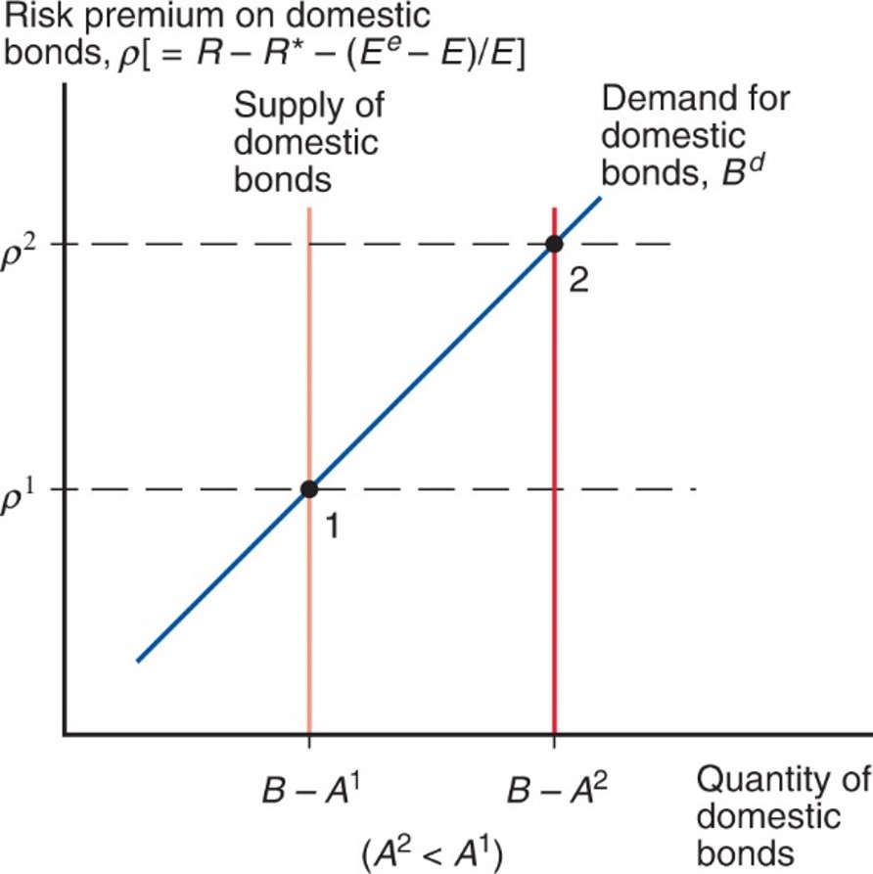
Figure 18A1.1 The Domestic Bond Supply and the Foreign Exchange Risk Premium Under Imperfect Asset Substitutability
An increase in the supply of domestic currency bonds that the private sector must hold raises the risk premium on domestic currency assets.
Notes:
Risk premium on domestic bonds =, rho left bracket = R minus R asterisk minus left parenthesis upper E super lower e minus E, right parenthesis, over E, right bracket. The plot for demand for domestic bonds, B super d, is a rising line that crosses supply of domestic bonds, a vertical line at x = B minus Ay super 1. Their intersection is at point 1, (B minus Ay super 1, rho super 1). When the bond supply is increased, the new intersection is point 2, (B minus Ay super 2, rho super 2), where Ay super 2 is greater than Ay super 1. Point 2 is above and to the right of point 1.

Slide 50
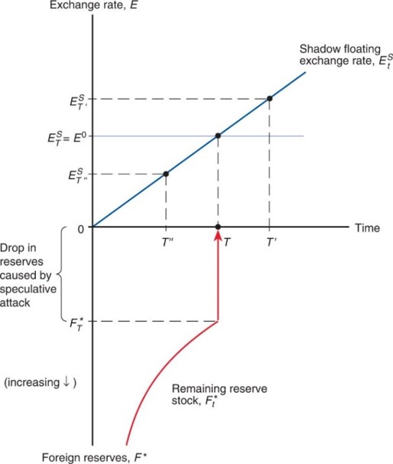
Figure 18A2.1 How the Timing of a Balance of Payments Crisis Is Determined
The market stages a speculative attack and buys the remaining foreign reserve
stock
at time T, which is when the shadow floating exchange rate
just equals the pre-collapse fixed exchange rate
Notes:
Above y = 0, the plot for shadow floating exchange rate, E sub t super S, rises as a straight line through 3 points. The first point is at (T double prime, E sub T super S double prime). The second point is at (T, E sub T super S = E super 0). The third point is at (T prime, E sub T super S prime). Below y = 0, the plot for remaining reserve stock, F sub t asterisk, rises with decreasing steepness to y = F sub T asterisk. The plot at this point is aligned on the x-axis with time, T, the second point on the shadow floating exchange rate plot. The vertical distance between y = 0 and y = F sub T asterisk accounts for the drop in reserves caused by speculative attack.

Slide 51

Copyright
This work is protected by United States copyright laws and is provided solely for the use of instructors in teaching their courses and assessing student learning. Dissemination or sale of any part of this work (including on the World Wide Web) will destroy the integrity of the work and is not permitted. The work and materials from it should never be made available to students except by instructors using the accompanying text in their classes. All recipients of this work are expected to abide by these restrictions and to honor the intended pedagogical purposes and the needs of other instructors who rely on these materials.

